Slide 1

Battle of the Neighborhoods Washington DC
Applied Data Science Capstone Project
By: Tim Andrews

Slide 2
Where to live in Washington dc
Washington DC is one of the fastest growing cities in the United States
Currently 700,000 people live within Washington DC’s borders, and over 6.2 million people in total live in the metropolitan area
Because people are moving into the city, people want to know where within the city to live
There are many factors that determine where one wants to live, but we will only be looking at two of them:
Local Restaurant/Food options
Crime Rate

Slide 3
Data acquisition and Cleaning
Zipcodes of the different Washington DC Neighborhoods were found at OpenData.dc.gov
Narrowed down to the 22 standard zipcodes
The Latitude and Longitude of each Zipcode was found on OpenDataSoft
A GeoJSON file of each zipcode was also found at OpenData.dc.gov in order to map the area of each
Local Food/Restaurant options for each neighborhood was provided by accessing Foursquare’s API
Every Reported Crime for the past Two Years in Washington DC was found at DC Atlas

Slide 4
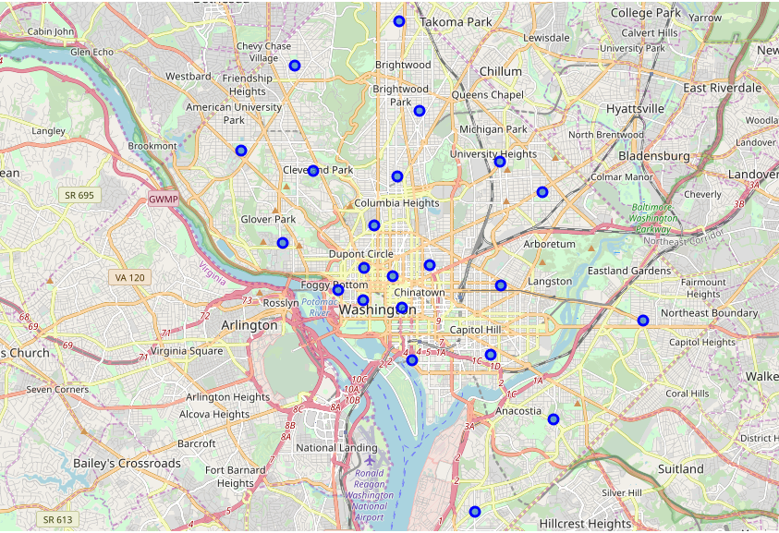
Washington DC neighborhood
Each Neighborhood is represented by a blue dot
22 in total

Slide 5
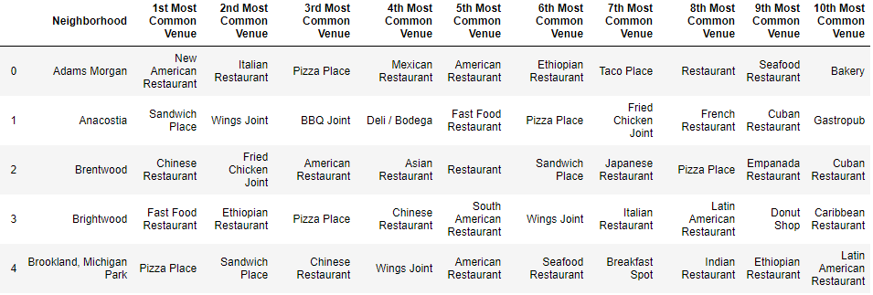
Top Restaurants for Each neighborhood via foursquare api

Slide 6
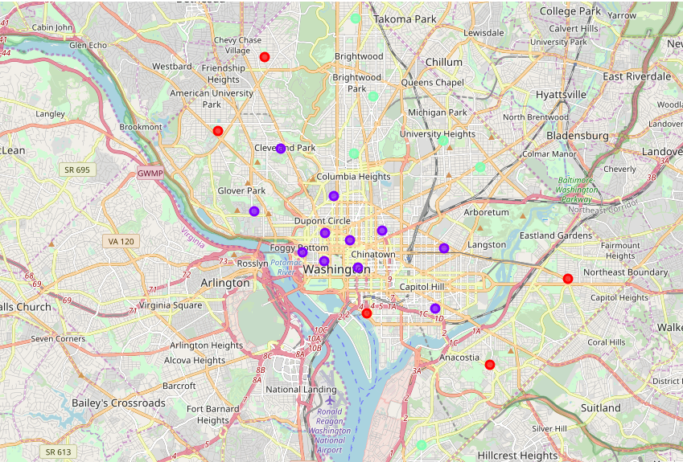
Washington DC neighborhood Clusters
Neighborhoods were clustered based on similarity of local restaurants
3 Clusters in total
Second Cluster (Purple Dots) picked for its diverse array of options (next slide)

Slide 7
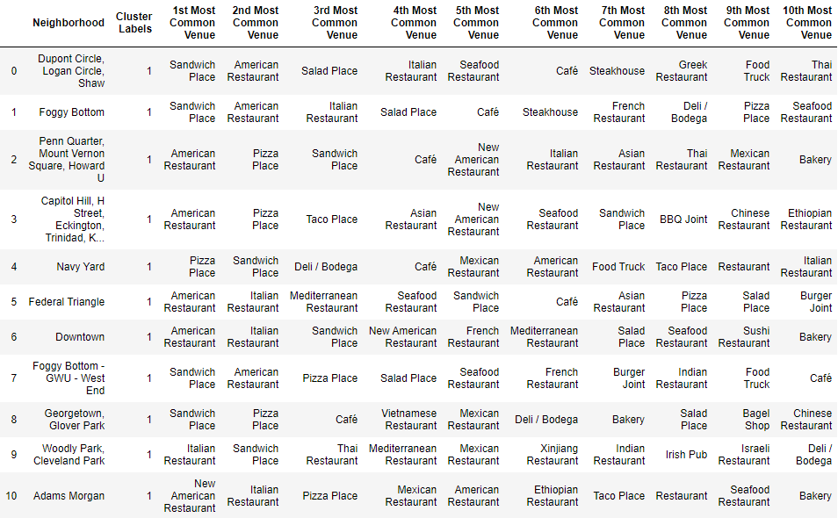
Second Neighborhood Cluster
Solid base of American, Italian, and Sandwich shops
Offers plenty of variety further down like Thai, Mediterranean, Asian, Seafood, Vietnamese, Mexican, French, and Ethiopian

Slide 8
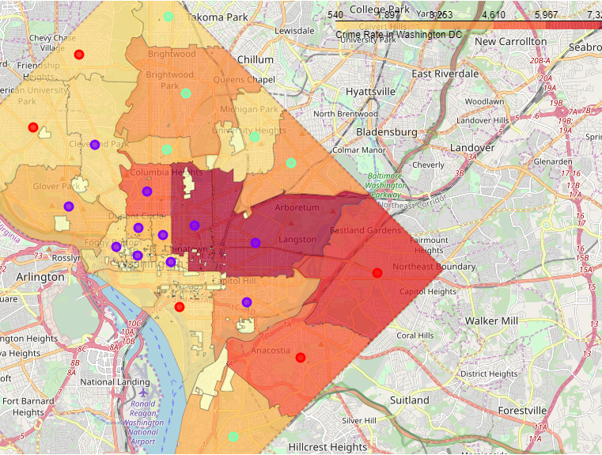
Neighborhood clusters with local Crime rate
Woodly Park/Cleveland Park, Foggy Bottom, Foggy Bottom/GWU/West End, and Federal Triangle have lowest crime rate amongst second cluster.
We remove Foggy Bottom/GWU/West End because of George Washington University

Slide 9
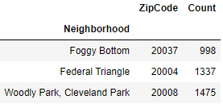
Lowest Crime Rate in Second Cluster
Order the remaining three neighborhoods by total crimes committed in the last two years
Foggy Bottom offers the most diverse array of local food options, while also having the lowest crime rate amongst its cluster of neighborhoods

Slide 10
Conclusion and Future Directions
Foggy Bottom would be the neighborhood that I would recommend to someone moving to Washington DC based on its variety of restaurants and low crime rates.
In the future, other data sources should be considered to expand upon the recommendation such as the average Home Price and/or the Average Yearly Rent.
This can also be drilled down further to determine which areas of a neighborhood should be looked at to move into or which specific street offers the best set living condiditons.

